Slide 1
Brands and Fakes
A move against duplicates

Slide 2
INTELLECTUAL PROPERTY RIGHTS
Intellectual property (IP) refers to creations of the mind, such as inventions; literary and artistic works; designs; and symbols, names and images used in commerce.
Intellectual Property Rights (IPR) are legal rights which safeguard creators and other producers of intellectual goods & services by granting them certain time-limited rights to control their use.

Slide 3
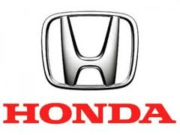
TRADEMARK
A trademark is defined as any mark, symbol, device combination of color which is used by one person /enterprise to characterize or distinguish his goods and services from others.
Here we can visualize different trademarks in daily life

Slide 4
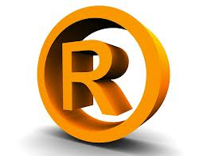
FORMS OF TRADEMARK
Trademark applied for
A trademark for which the application has been filed but it is yet to be registered is called as unregistered trade-mark. It is symbolized by the given mark.
Registered Trademark
A trademark which is registered is called as registered trademark. It is symbolized by the given mark.

Slide 5
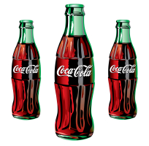
TRADE DRESS
A trade dress is actually a visual characteristic of a product. It can be design, color, packaging or the layout of the product.
Trade dress of Coca-Cola
Shape of the bottle
Coca-Cola written in white on the bottle

Slide 6
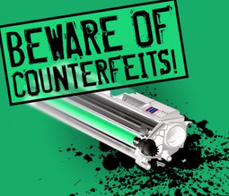
INTELLECTUAL PROPERTY INFRINGEMENT
Intellectual Property (IP) Crime is any violation or infringement of the rights of the owner of a trademark or copyright or patent etc.
IP infringements costs the global economy more than US$200 billion each year.

Slide 7
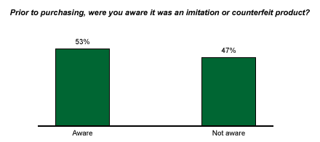
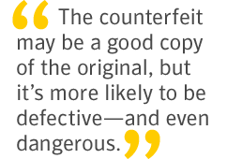

Slide 8
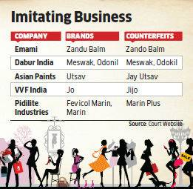

Slide 9
TYPES OF VIOLATION
Counterfeiting
Trademark Infringement
Software Piracy
Copyright Infringement
Patent Infringement

Slide 10
COUNTERFEITING
Similar to original product in terms of colour, size, design, shape and packaging and easily deceive consumers.
Tips to identify fakes
1- Check for Expiry Date 2- Check for Brand Logo 3- Check for Bar Code print on
packaging 4- Color Scheme.

Slide 11
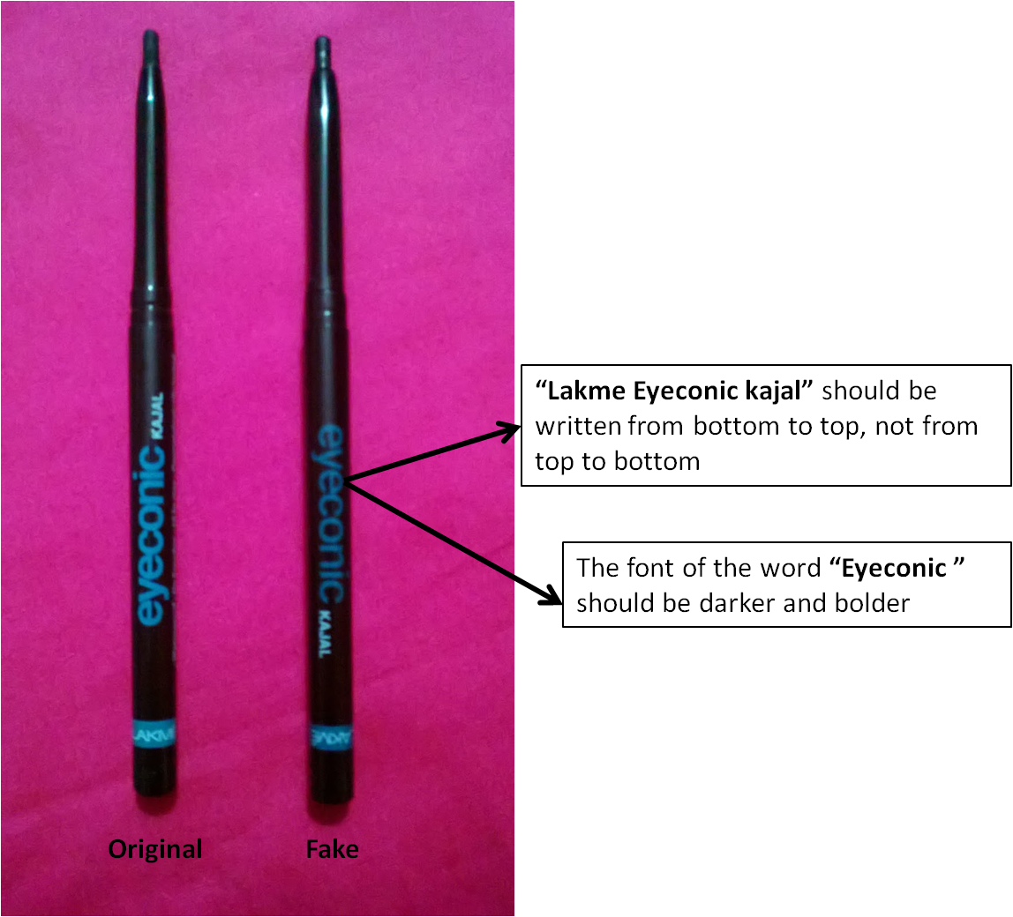
COUNTERFEITING
Lakme Eyeconic Kajal

Slide 12
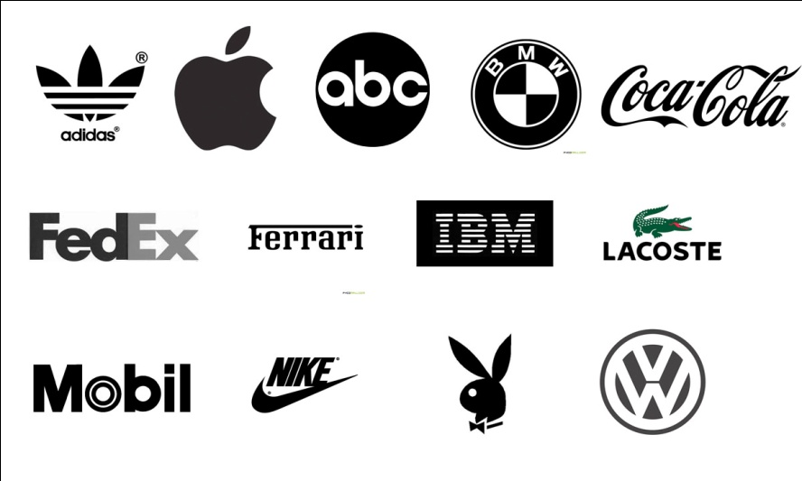
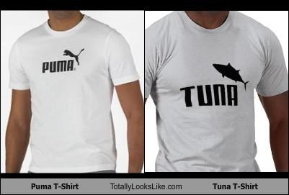
TRADEMARK INFRINGEMENT
Copying of Logos
Easy to reprint logo
Misleads consumers
Creates Confusion
Here you can clearly visualize the difference between real puma logo and fake logo.

Slide 13
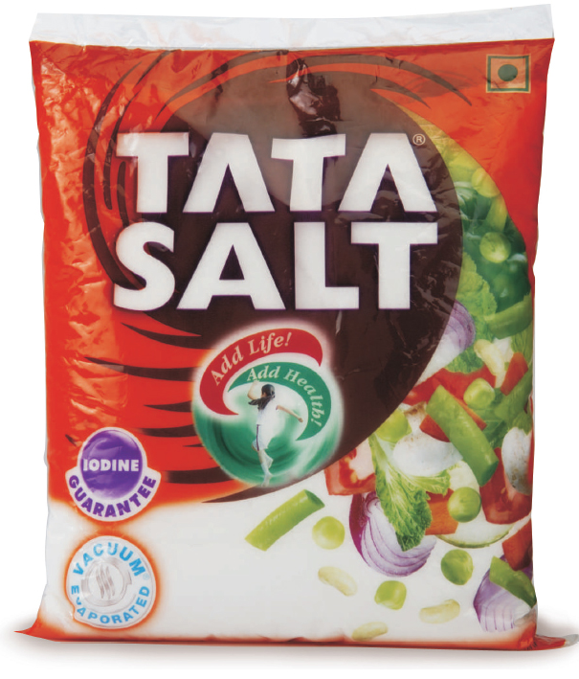
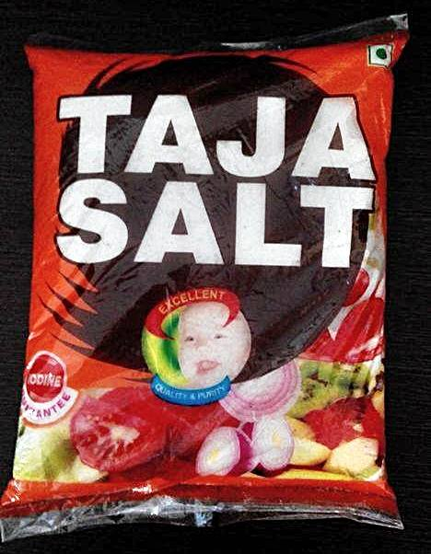
TRADE DRESS INFRINGEMENT
TATA SALT vs. TAJA salt

Slide 14
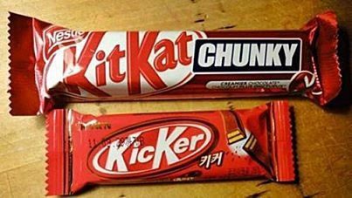
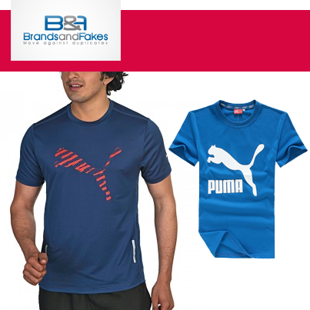
COPYING OF LOGO
Design Copy
Easy to copy design
Creates consumer confusion
Color Copy
Easy to confuse customers
Loss of revenue for companies

Slide 15
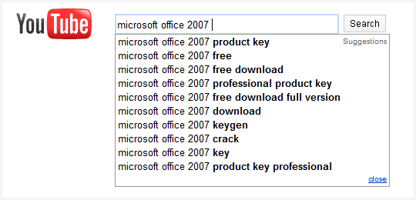
SOFTWARE PIRACY
MICROSOFT WINDOWS

Slide 16
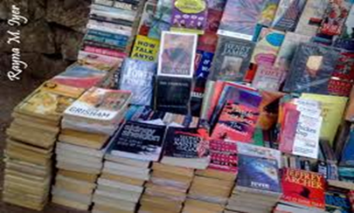
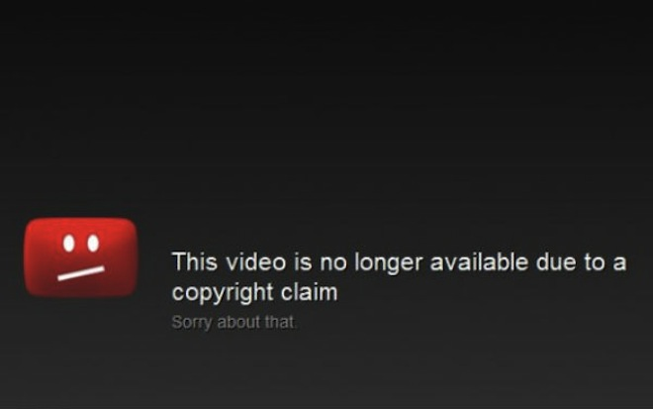
COPYRIGHT INFRINGEMENT
Piracy of Software
Piracy of Books
Piracy of Music
Some users post videos clippings from movies without taking permission from the copyright owner, which is illegal under the copyright act.

Slide 17
PATENT INFRINGEMENT
Apple vs. Samsung

Slide 18
Case study for some of known Brands

Slide 19
Case study for Battery

Slide 20
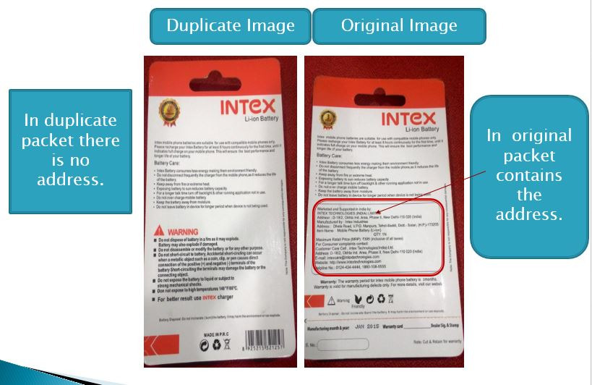

Slide 21
Case study for Power Bank

Slide 22
Case Study for Hair Cream

Slide 25
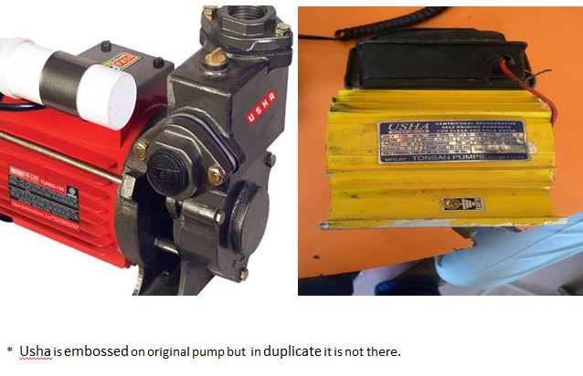
Case Study for Pump

Slide 26
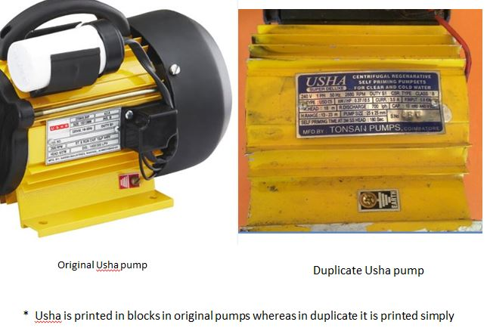

Slide 27
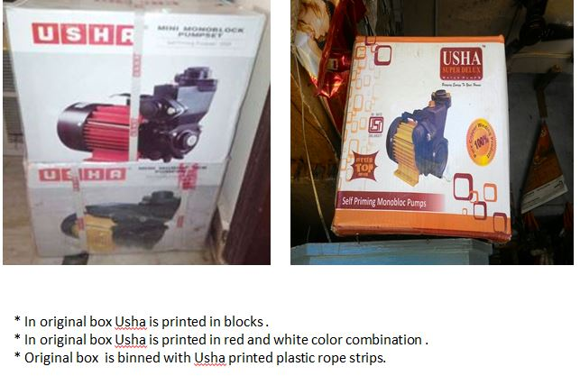

Slide 28
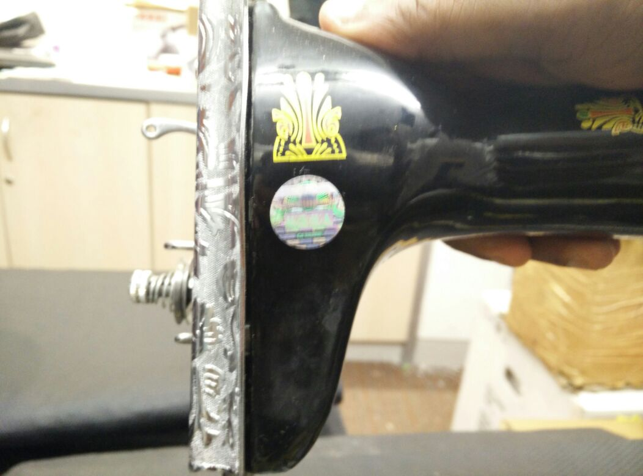
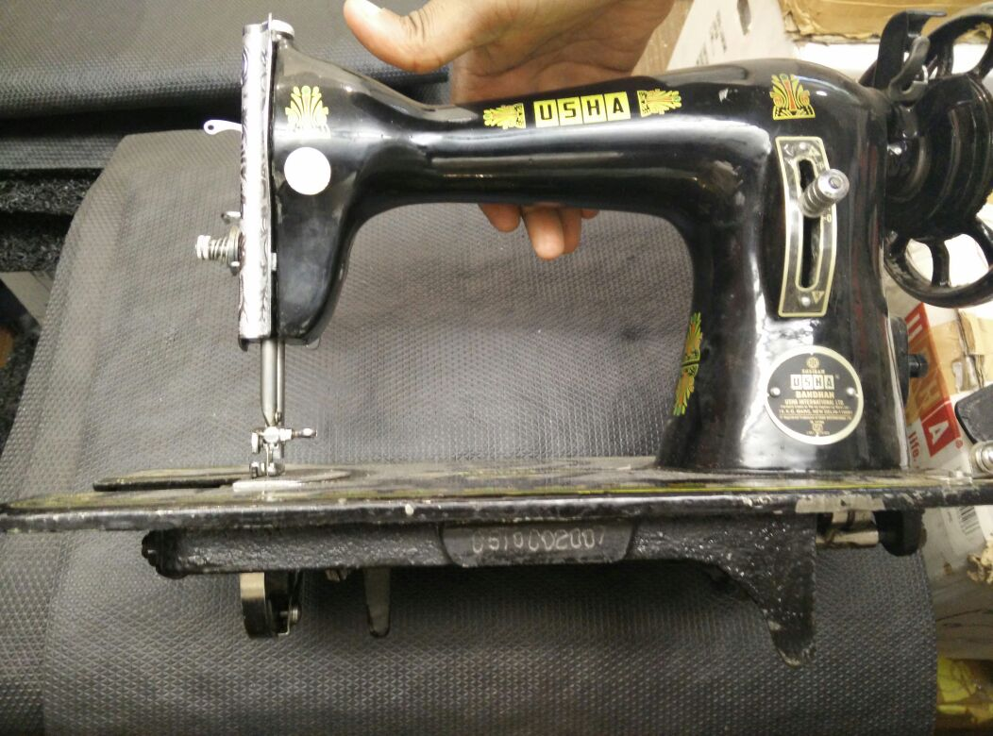
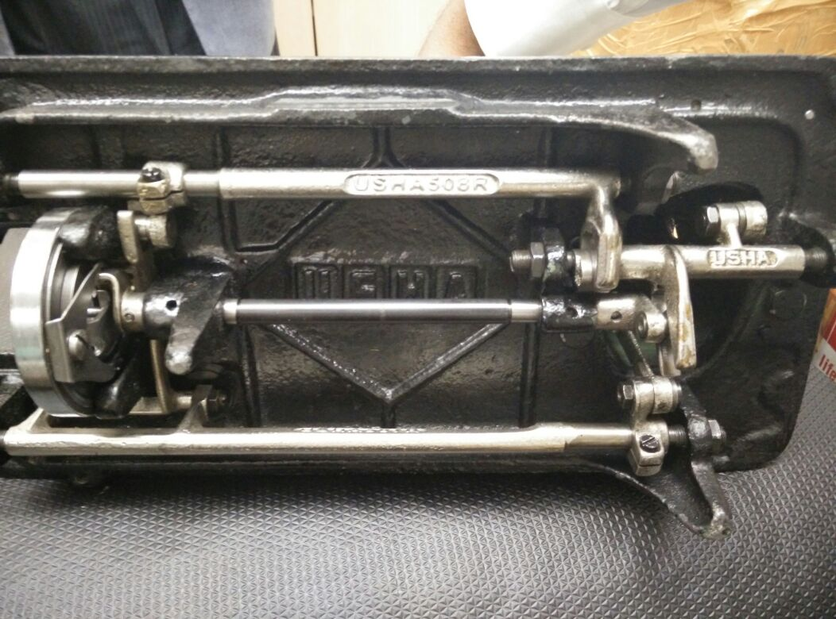
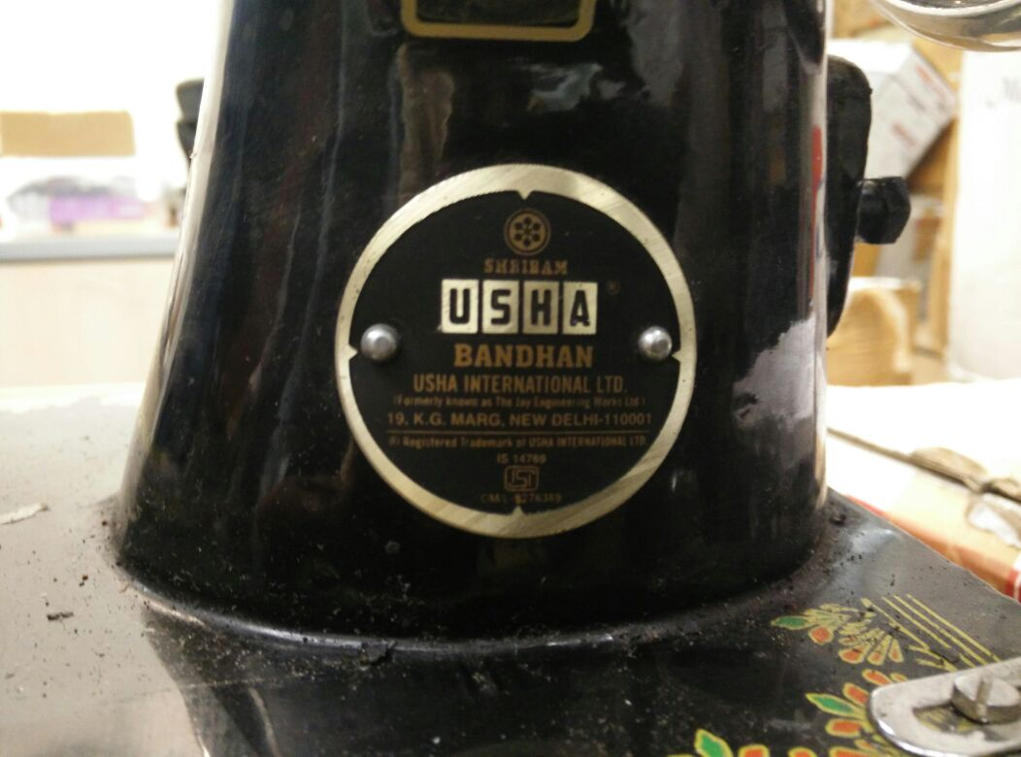
Case Study for Sewing Machine

Slide 29
Case Study for Washing powder

Slide 30
Case study for Detergent Cake

Slide 31
Case Study for Washing powder

Slide 32
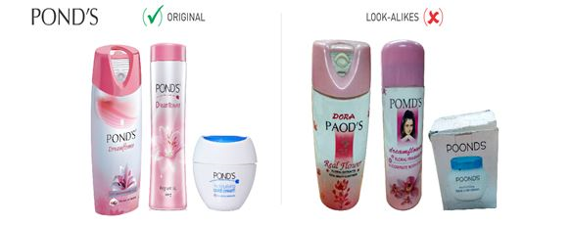
Case Study for Talcum Powder

Slide 33
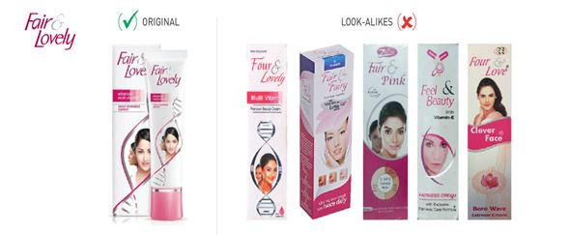
Case Study for Skin Cream

Slide 34
Our vision
To be a global leading integrated platform to fight counterfeiting
Our mission
To bring over 3,00,000 brand protectors/ volunteers in the Brands and Fakes ecosystem.
To provide brand protection services to 500 leading brands in India.
To be a preferred collaborative platform to over 250 brand protection agencies.
Position Brands and Fakes as a prestige platform for all brand conscious consumers

Slide 35
OUR CLIENTS

Slide 36
Trademark | Relevance for BNF | Brand Impact | What to report | Type Of action
Trade dress | High | Loss of revenue Degradation of Brand quality | Product Photo Types of products manufactured | Pass on information to brands Reward Fight for social cause
Logo design | High | Consumer confusion Revenue loss | Product Photo No of logos produced | Reward Fight for social cause
Logo Color with similar designing | High | Loss of revenue Degradation of Brand quality | Photo of product No of products manufactured | Action against culprit Reward Fight for social cause
Counterfeits | High | Consumer confusion Revenue loss | Product photo Shop/store address | Action against culprit Reward
Tagline Copy | High | Consumer confusion Revenue loss | Product photo details of taglines | Action against culprit Fight for social cause Reward

